Slide 1
The BRIDG model: a shared domain analysis model of regulated clinical research
Douglas B. Fridsma, MD, PhD, FACP
Center for Biomedical Informatics
Center for Pathology and Oncology Informatics
University of Pittsburgh

Slide 2
Acknowledgements –leadership
Leadership and collaboration
  CDISC board members
  Becky Kush, CDISC
  Sue Dubman, NCI
  Charlie Mead, HL7
  Barbara Tardiff, Linda Quade, Randy Levine, RCRIM technical committee of HL7

Slide 3
Acknowledgements –modelers
Ed Helton
Pierre-Yves Lastic
Tony Friebel
Don Kacher
Barbara Tardiff
Chuck Jaffe
Frank Newby
Sally Cassels
Nitin Gupta
Landen Bain
Laura Altshuler
Steve Ruberg
Elaine Job
Becky Kush
Sylvia Collins
Udo Siegman
David Hardison
David Iberson-Hurst
BRIDG group
  Christo Andonyadis
  Greg Anglin
  Lisa Chatterjee
  Julie Evans
  Douglas B Fridsma
  Smita Hastak
  Joyce Niland
  John Speakman
  Cara Willoughby
  Diane Wold
  Peter Ambramovich

Slide 4
Organizational Involvement
Pharmaceutical companies
  AstraZeneca
  Boehringer-Ingelheim
  Eli Lilly
  Glaxo Smith Klein
  Merck
  Novartis
  Pfizer
  Sanofi-Aventis
Technology companies
  IBM
  SAS
  Fast track
  SAIC
  BAH
  Oracle

Slide 5
The Pillars of (Semantic) Interoperability
Necessary but not Sufficient
Common model across all domains-of-interest
  The structured protocol representation in BRIDG
Model grounded on robust data type specification
  Common data elements in the caDSR
Methodology for binding terms from concept-based terminologies
  UML loader, semantic connector
A formally defined process for defining specific structures to be exchanged between machines, i.e. a “messaging standard”
  HL7 and implementation specifications
  caBIG unified process/model driven architecture

Slide 6


Standards – Why?
Cancer Research: Two Different Worlds
Acknowledgements:
Landen Bain, CDISC
Patient
Data in
Proprietary
Format
BRIDG
Patient Care World
Multiple data sources and types
HL7 is a pervasive standard
Data are organized around the patient
Clinical Research World
Protocol defines define elements
Linear data flow
CDISC is the emerging standard
Data are organized around a trial

Slide 7
What is BRIDG?
An open community of stakeholders interested in developing standards for exchanging information about clinical trials
  HL7 Domain analysis model in Regulated Clinical Research (RCRIM) technical committee
  caBIG analysis model for model-driven development
  CDISC integrating model for current standards
A bridge between
  clinical trial domain experts and technical experts
  different models of clinical trials information
A formal model of the shared semantics of regulated clinical trials research
The semantic foundation for application and message development in HL7, caBIG, and CDISC

Slide 8
“Protocol” and the Semiotic Triangle
Concept 1
Concept 2
“We need to sign off on the protocol by Friday”
  “Protocol XYZ has enrolled 73 patients”
Thing 1
Symbol
“Protocol”
Thing 2
Document
Study
Concept 3
Thing 3
“Per the protocol, you must be at least 18 to be enrolled”
Plan
Source: John Speakman/Charlie Mead

Slide 9
The Communication Pyramid:
Communicating complexity is HARD
How do you link the people who know about clinical oncology (domain experts) with the technology implementers who will develop tools to support clinical work so that we have semantic interoperability?
The Problem Space (Domain Space)
  A structured way to describe and document the information requirements of a particular area of interest
  “What”
  Discovered through Analysis
The Solution Space (Implementation/Technical Space)
  “How”
  Discovered through Design
  One Problem → Many Solutions
The domain analysis model (SPR) is a bridge between domain experts and technical experts

Slide 10
The Communication Pyramid
Domain Analysis Model (SPR)
`
Non-standard Graphics
Domain Experts
ad hoc Drawings
Technical Experts
Structured Documents
Free-text Documents
Discussions
Communication
Source: Charlie Mead, MD, HL7

Slide 11
“The Map is not the Territory”
(Bertrand Russell)
Domain Experts have a “mental map” of the Problem Space
  Noam Chomsky “Syntactic Structures” (1975)
    Deletion (filtered/missing details)
    Distortion (incorrect or modified details)
    Generalization (abstractions via rules, beliefs, principles)
    Distortion and Generalization share…
    … Inappropriate/incorrect use of universal qualifiers
      All
      Everyone
      Always
      Never
      Nobody
      None

Slide 12
The Map is not the Territory
Deletion – “They use the system to borrow books.”
  Challenge: “Who uses the system to borrow books?”
  Response: “Library members, librarians, other libraries.”
Distortion – “Borrowers can’t borrow another book until all overdue books are been returned.”
  Challenge: “Are there any circumstances where a borrower can borrow a book before all overdue books are returned?”
  Response: “Yes, two circumstances….”
Generalization – “Everyone must have a ticket to borrow books.”
  Challenge: “Are there any system users that can borrow books without a ticket?”
  Response: “Librarians and other libraries have a different type of ticket.”

Slide 13
What Is A Domain Analysis Model?
“An implementation-independent view of the Problem Space from the Domain Expert’s perspective”
Minimum components
  Static View
    Concepts, Attributes, Relationships
    Complete, unambiguous documentation (GLOSSARY)
    UML Class Diagram
    Appropriate partitioning of sub-domains and layers 0f abstraction (Packages)
    Exemplar Instance Diagrams
  Dynamic View
    Storyboards
    UML Activity Diagram representations of Storyboards
    State diagrams of suitably ‘interesting’ static classes
  In the end, if the model’s collective view unambiguously specify the Problem’s semantics (dynamic and static), the ‘correct’ views have been constructed

Slide 14
Vision of the SPR SIG in caBIG
To define a computable protocol representation that supports the entire life-cycle of clinical trials protocol, and develop tools that use these protocol representations. These tools should be standards-based, caBIG compliant and assist users in creating, maintaining, and sharing clinical trials information.
The clinical trials protocol representation will serve as a foundation for caBIG modules that support all phases of the clinical trials life cycle, (including protocol authoring) and be developed to meet user needs and requirements.

Slide 15
Vision of the SPR SIG in caBIG
To define a computable protocol representation that supports the entire life-cycle of clinical trials protocol, and develop tools that use these protocol representations. These tools should be standards-based, caBIG compliant and assist users in creating, maintaining, and sharing clinical trials information.
The clinical trials protocol representation will serve as a foundation for caBIG modules that support all phases of the clinical trials life cycle, (including protocol authoring) and be developed to meet user needs and requirements.
BRIDG

Slide 16
Domain Space Analysis Model: Timeline
2001-2002
2003
Jan 2004
Mar-Aug 2004
Aug-Oct 2004
Nov 2004
Dec 2004
Early attempts to map ODM to HL7 RIM
...
Dr. Mead’s Report to CDISC Board of Directors
Initial DSAM Development, by Dr.Mead
Feedback Review of DSAM with Focus Groups
Initial Modeling of Protocol Elements in DSAM
Begin Mapping CDISC ODM to HL7 V3 RIM
Reps from:
CDISC
HL7
Reps from:
CDISC Board
CDISC Teams
HL7 RCRIM
TCC
NCI
Reps from:
NIH/NCI
FDA
EHR/eSource
TCC
HL7 RCRIM
CDISC teams
CDISC IAB
Involvement from:
CDISC
NCI
RCRIM inv.
Reps from:
CDISC
NCI/caBIG
HL7 RCRIM
HL7 V3 RIM Implementation of
CDISC LAB Model ->
ANSI Accreditation;
Assistance for ODM sought
from L.Bain, C.Mead
SDTM Announced by HHS/FDA;
eSubmission made w/ define.xml
ODM Production V1.2 (XML Schema) - Industry Adoption and Tool Development →

Slide 17
Merging the caBIG and CDISC projects
Fall 2004 – caBIG identified “best of breed” models in the CDISC standards and HL7 messages
November 2004 – First joint CDISC/HL7/caBIG modeling session
Between November 2004 and March 2005 – multiple modeling sessions to develop the “scaffolding” of the domain analysis model (SPR)

Slide 18
Community review
Since then, model has been reviewed by a number of caBIG and HL7 members
Changes to the model based on the review and anticipated future harmonization tasks
Have begun work on the business process decomposition (with primary focus on pharmaceutical processes)
  Cara Willoughby
  Greg Anglin
  Diane Wold
  Joel Hoffman
  (and others)

Slide 19
Feedback from the initial BRIDG model
Linda Quade, Mead Walker, Charlie Mead, others
The model is big, complex, and difficult to navigate
The scope of the model is ill-defined
The levels of abstraction are inconsistent
The model is static heavy, and needs additional work on the dynamic aspects of the model, linked to the static structures

Slide 20
Restructuring BRIDG
Moved much of the old parts of the model that reflect the evolution of our thinking to a separate package
Created a structure in the model that is similar to the RIM backbone to help organize the model
  Recognized that Entities and Roles will be relatively stable, but the real complexity will be in the activities and (possibly) the participations
Created “views” that reflect smaller parts of the model
Staging area in the model for parts of the model that are in the process of harmonization

Slide 21
Current projects in BRIDG
Models being staged for harmonization
  Clinical Trials Object Model (CTOM) from NCI (90%)
  SDTM from CDISC (20%)
  caAERS from City of Hope AND Patient Safety model from HL7 (pending, mid-Feb)
  eDCI model from NCI/Oracle (pending)

Slide 22
BRIDG Sub-Projects
Trial Design Model
    Based on CDISC and FDA/Janus standard
    Developing common concepts and understanding for arms, treatment groups, visits, cycles, courses, etc.
    At present, input from Pharmaceutical companies thru CDISC and FDA
    Current Status –
      Recently worked with CDISC SDTM team to model SDTM requirements
      Plans to harmonize with BRIDG
Notes:
Trial design
CDISC trial design subcommittee has moved their work into enterprise architect and UML modeling to speed the development efforts
Update the model every 2 weeks with results of teleconference
Statistical design
eDCI subproject
General purpose HL7 message to describe a data capture instrument, or case report form. Using HL7 “early adopter” mechanisms.
Actively using gForge documents, forums, webpages, and CVS repository
Clinical Registry message
Development of an HL7 message for registering a clinical trial in a clinical trial repository
Eudract (europe)
Clinicaltrials.gov, PDQ
Traditional HL7 project development (not early adopter)
Adverse events
First significant sub-model to be harmonized
Will lead to both application development and message specification
Harmonization branch and maintenance
Additional definitions added from CTOM
Reference implementation
Cleaning up the model and definitions

Slide 23
Example: Dissimilar Arms
Epoch
Screen
Run-In
Treatment
Follow-up
Arm
Arm segment
Trt Phase 1
Trt Phase 2
Follow-up
Screen
Run-In
Standard Care
Follow-up
Source: Diane Wold - GSK

Slide 24
BRIDG Sub-Projects (cont’d)
  Statistical sub-Model
    Based on CDSIC Statistical specification – ADaM (Analysis Data set Model
    ADaM provides models for commonly used statistical analysis
    Some early classes in this UML diagram are: Hypothesis,
    Analysis, SampleSizeJustification, AnalysisSetCriterion, etc.
    Current Status –
      very early development of the model
      Input only from Pharmaceutical and CRO

Slide 25
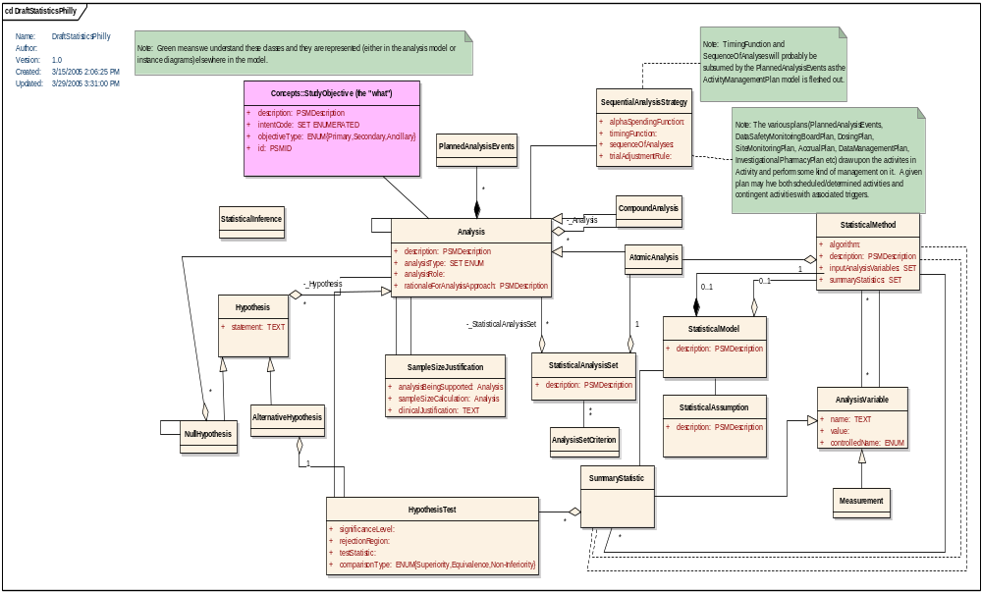
Statistical Model (work-in-progress

Slide 26
BRIDG Sub-Projects (cont’d)
  Clinical Trial Registry
  Objective: To define requirements for registering a clinical trial in a clinical trial repository
  Requirements being developed by NCI and CDISC
  Working with PDQ, clinicaltrials.gov and European EUDRACT
  Have recently established collaboration with the WHO activity of clinical trials registry
    Becky Kush (CDISC president) on the advisory board
    Jan 25-28 – harmonization session in Washington DC with CDISC/HL7/WHO models
    Working with cancerGRID to incorporate and make explicit the CONSORT model
  Current Status –
      Group has defined a list of 70 elements
      Planning to model these into BRIDG
      Planning on developing a HL7 v3 message
      POC – Lakshmi Grama, NCI

Slide 27
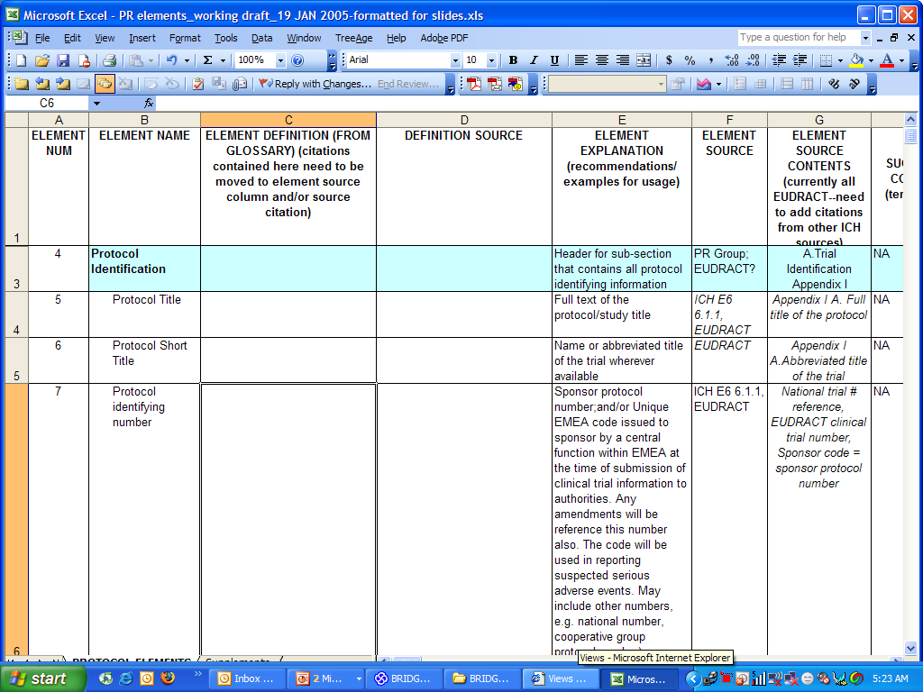

Slide 28
BRIDG Sub-Projects (cont’d)
  eDCI message (electronic Data Capture Instrument)
    A DCI is a set of related questions for which values are to be collected during a clinical trial visit.
    This model will be used as an HL7 message definition (or a set of definitions) that can be used to transmit a DCI Definition between databases managed by clinical data management systems (CDMS).
    Participation from NCI, CDISC, Oracle
    UML model on bridgproject site -- https://www.bridgproject.org/edci/
    Current Status –
      Requirements have been defined for 1st iteration
      UML class diagram is completed
      Plans to harmonize with BRIDG
      Working on building the message specification (RMIM)
      POC – Don Kacher, Oracle
Notes:
In addition to questions, a DCI (for the purposes of this modeling effort) also contains instructions on the rendering of the prompts for the questions, the relative positioning of questions, and rules for non-default navigation among questions

Slide 29
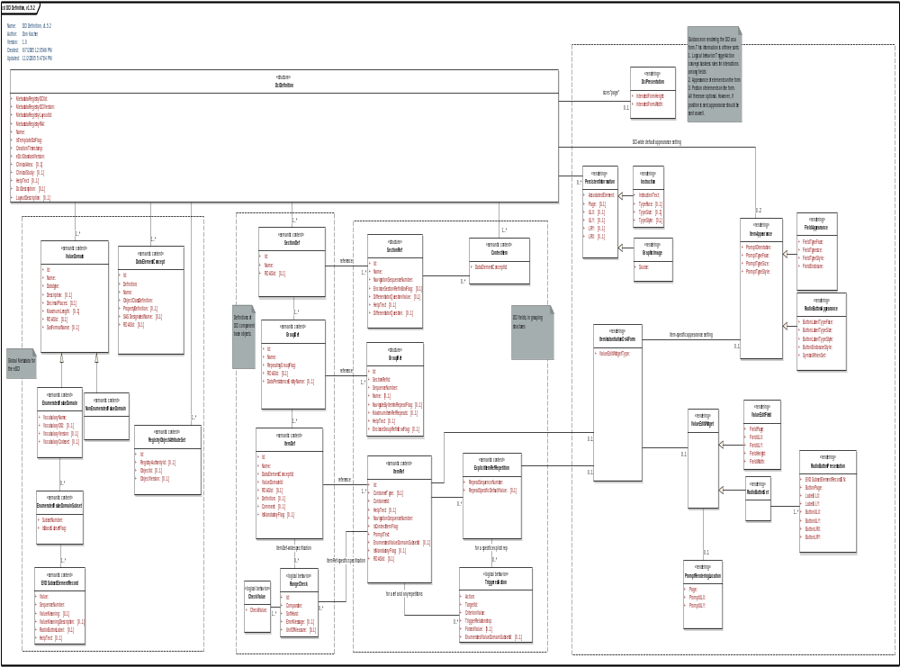
eDCI UML class Diagram
DCI
Definition
(aka CRF)

Slide 30
BRIDG Sub-Projects (cont’d)
Protocol Representation
  Integral part of the BRIDG model
  Initial requirements based on CDISC developed list of elements
  This list of elements were “vetted” by CDISC constituents and represent their international community
  It is based on ICH E6 and has a Document view of the Protocol
  Current Status –
      Work in progress – integrating back into the new BRIDG organization

Slide 31
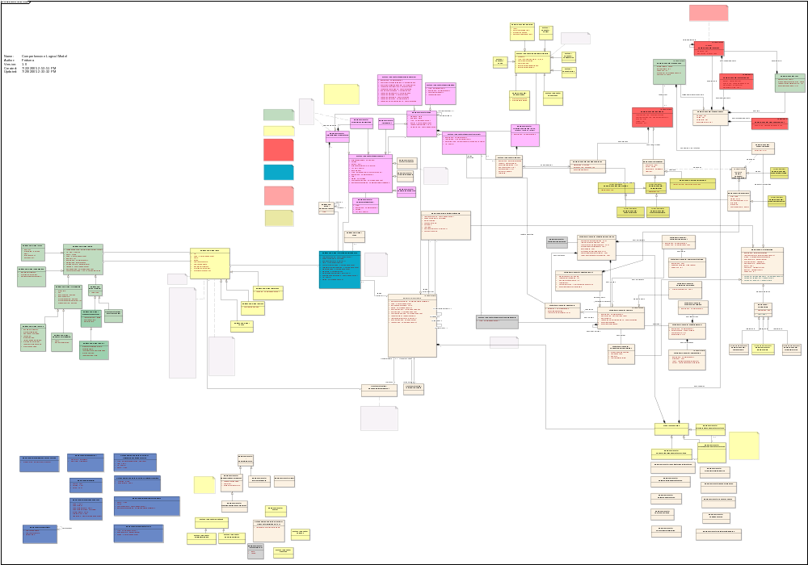
Clinical Trial Design
Protocol Authoring
and Documentation
Clinical Trial
Registration
Protocol activities and
Safety monitoring (AE)
Structured
Statistical Analysis
Eligibility
Determination

Slide 32
BRIDG development
Top-Down scaffolding Development
BRIDG
Use case driven, subproject Development

Slide 33
Current Status
URL for the BRIDG project
  www.BRIDGproject.org
Active participation from CDISC, pharmaceutical companies (GSK, Lilly, others), and industry (Fasttrack, ScenPro, Oracle), caBIG (COH, UPMC, MSKCC, and others)
  Committing real resources and time to the effort
  A true collaboration with the various stakeholders in the effort
Face-to-Face caBIG meeting
  April 9th-11th in Crystal City, VA

Slide 34
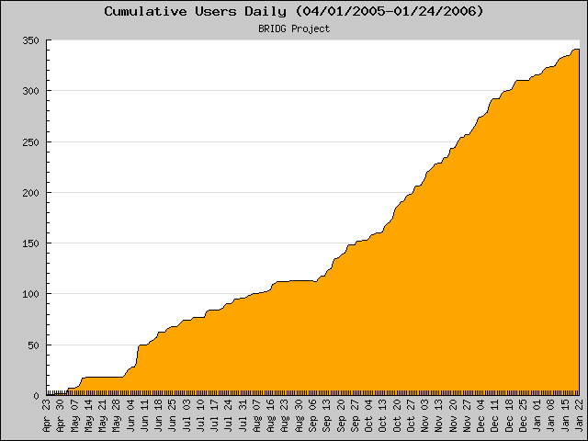
Cumulative Registered Users

Slide 35
Organization of BRIDG
BRIDG Advisory Board
  Representation from the current key stakeholders in the model
    CDISC, NCI, HL7
    Representation from PhARMA
  Provides strategic guidance for priorities and collaboration
BRIDG technical harmonization group
  Responsible for the “mechanics” of model maintenance and harmonization
Multiple subprojects
  Use some of the shared resources, but primarily volunteer

Slide 36
Establishing a comprehensive educational program around BRIDG
Targeting various learners
  Domain experts
    How do you contribute your expertise into the model?
    Storyboards, use cases
  Modeling experts
    How do you take the storyboards and use cases and construct formal models of the expertise?
      Modeling best practice
  Technical experts
    How do you take these formal models of expertise and create applications that address these problems?
Various ways to learn
  HL7 tutorial in January 2006
  Webinar in February and March 2006
  CDISC/HL7 joint meeting in Berlin, April 2006
  Bootcamp for deep understanding of the model (?March)

Slide 37
Ways to participate
HTML view of the model
  www.bridgproject.org/model
  Updated ever 10-14 days – represents the current active model
Trackers
  Modeled after HL7 Harmonization forms
  Useful for smaller comments, definitions, suggestions
Download the model from the CVS repository or file release
  file release
  CVS repository
Active model development in subprojects
It is likely that there are a range of individuals within a particular organization that can contribute – domain experts, modeling experts, and technical experts

Slide 38
What does it mean to “adopt BRIDG” or “harmonize with BRIDG?”
Adopting and harmonizing with BRIDG is a two-way street
  The model is not complete, and harmonization and adoption requires participation and contribution to BRIDG from others
  The model is new and is changing, so harmonization and adoption requires flexibility and change
Early adopters will have a more significant impact on the direction and development of BRIDG
Adopting and harmonization with BRIDG is less about a commitment to a specific model, but the realization that
  A common standard is a shared good that all can benefit from
  It will require contribution and collaboration as we collectively determine the best approaches
  It will require compromise and collective action

Slide 39
Final thoughts: our approach to modeling
Scope – keep it clear and focused (ie, solve a problem that exists) and standardize to the extend needed
  Refine through experience, and not endless discussions. This keeps the modeling effort clear and focused
  BRIDG is not complete – but the scaffolding is there to help organize the analysis and model development in subprojects
Keep it generic, faithful, free of implementation specific formalisms, and supporting the requirements
If the tools and models don’t work with reality – it is probably the tools and the models that need to change
If it’s broke, fix it
  The model is in evolution with known problems – the problems should be an opportunities for improvement and a call to arms, not barriers to use
Model in the open
Collaborate until it hurts
With thanks to Dipak Kalra for discussion

Slide 40
Fridsma@cbmi.pitt.edu caBIG.nci.nih.gov https://www.BRIDGproject.org

Slide 41
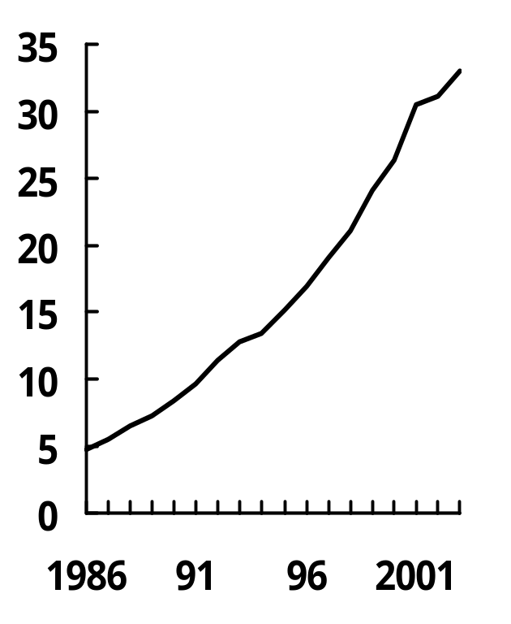
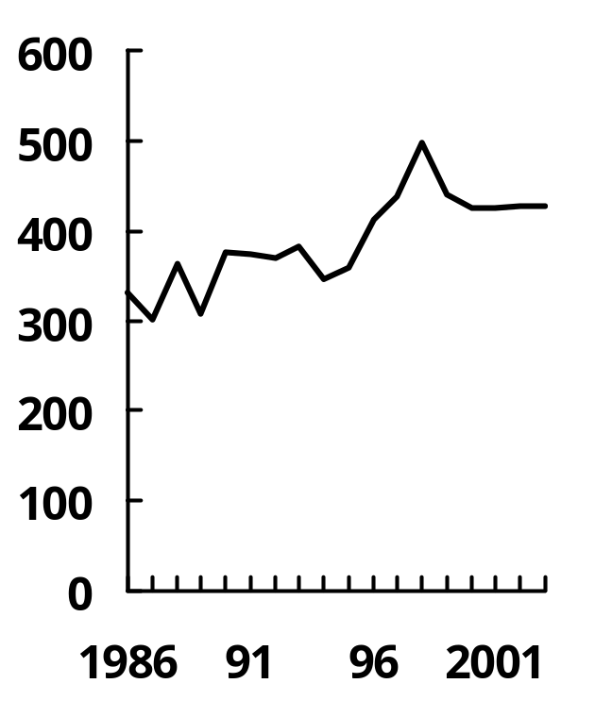
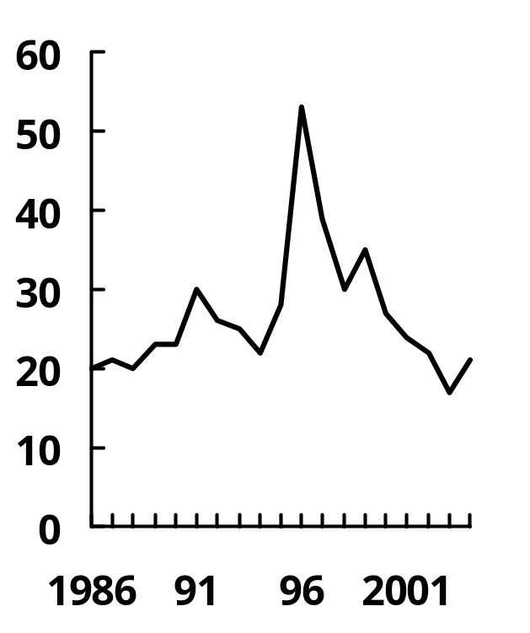
BioPharma R&D Conundrum
R&D Expenditures ($B)
1986-2004
Investigational New Drug Applications
1986-2004
New Chemical Entities
Approved
1986-2004

Slide 42
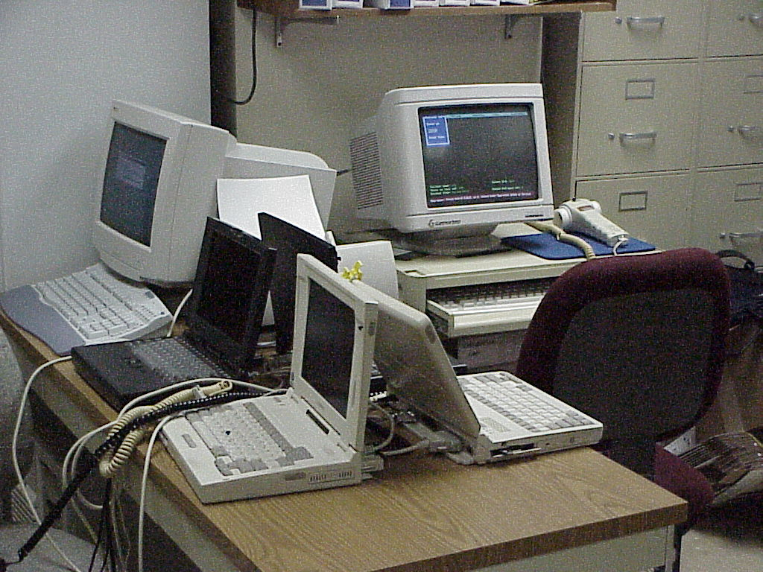
Clinic Research back office… after the paper is gone
1
6
5
2
3
4

